Slide 1
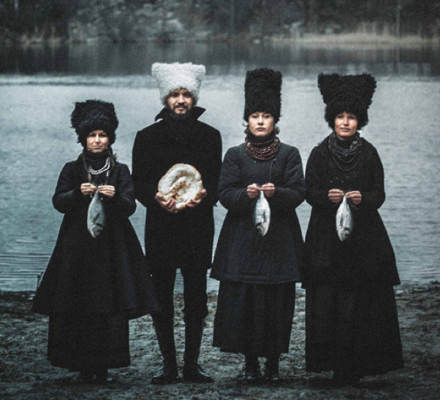
DahkaBrahka

Slide 2
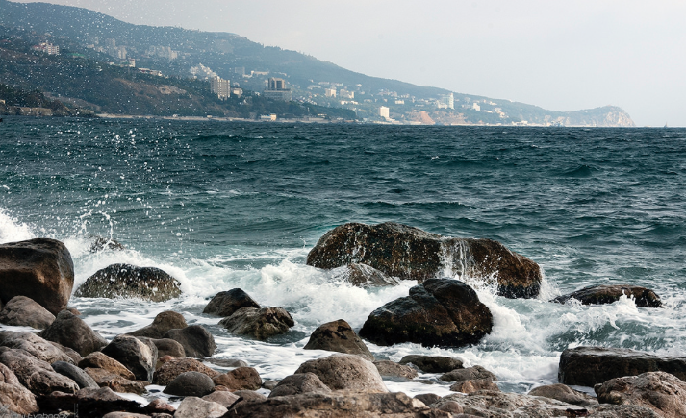
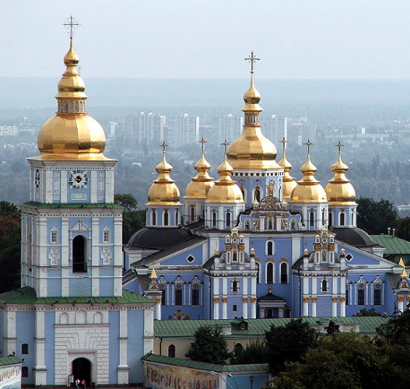
Where are they From?
The Ukraine!

Slide 3
Who are they?
Marko Halanevych
Nina Harenetska
Iryna Kovalenko
Olena Tsybulska
They see themselves as
“Ambassadors of
Ukrainian Culture”

Slide 4
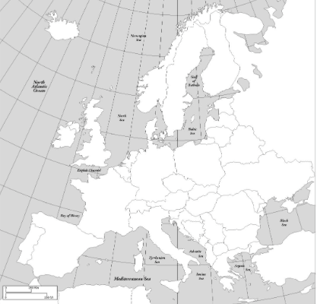
Where is it?

Slide 5
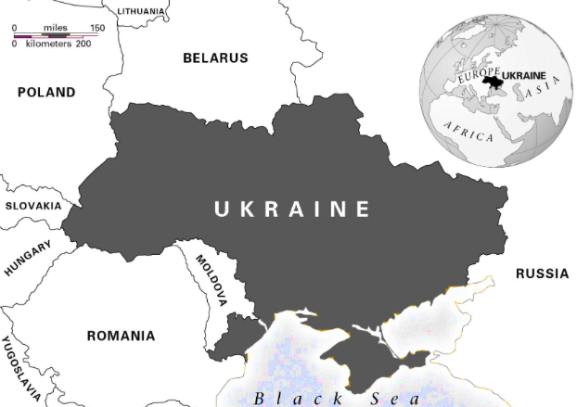
Key Locations: Kiev, Chernobyl, C.P.
Chernobyl
KIEV
Crimean Peninsula

Slide 6
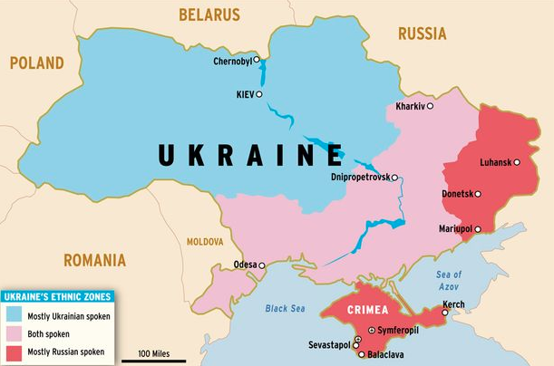

Slide 7
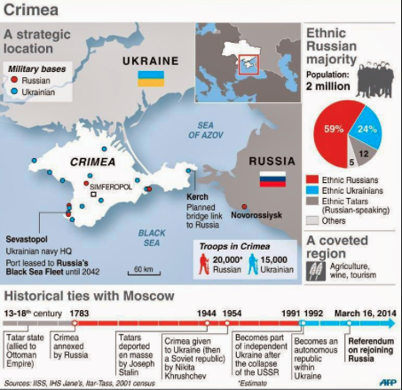
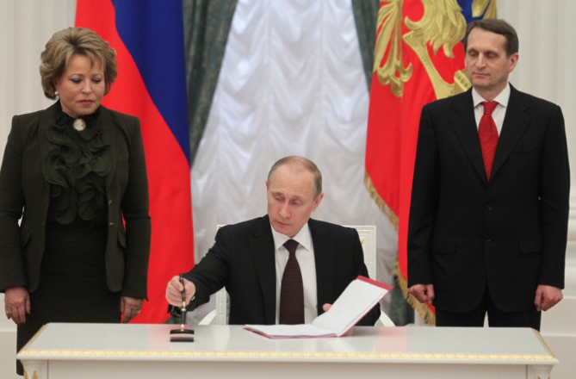
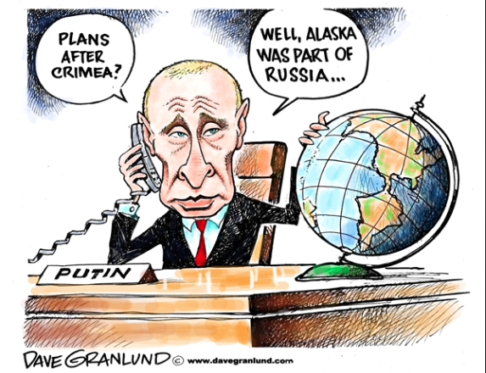
Why is Crimea important now?
Notes:
Three years ago this Saturday, Russia formalized the first forced annexation Europe has seen since the Second World War. Stating that “Crimea has always been an inseparable part of Russia,” Russian President Vladimir Putin laid claim to Ukraine’s southern-most peninsula. Moscow pointed to a faux “referendum” held two days prior as justification — a vote that saw Russia claim 97-percent support for annexation, and which was monitored by neither UN nor OSCE officials. Simultaneously inflating Russia’s geographic reach and near-pariah status, Moscow’s claim of annexing the peninsula presented its foremost attempt to date to gut the post-Cold War order.
TheDiplomat.com

Slide 8
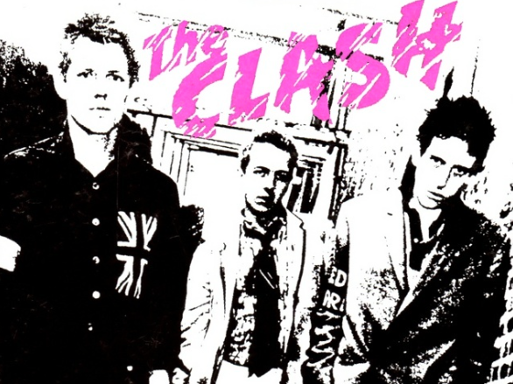
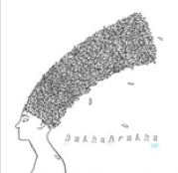
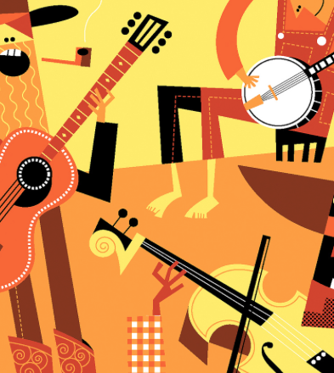
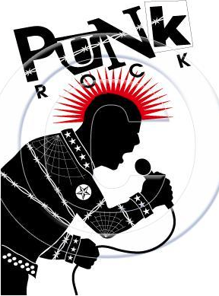
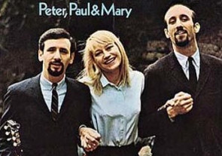
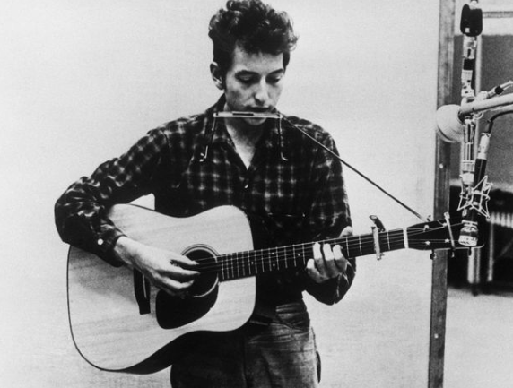
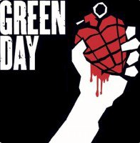
DahkaBraka – Ukrainian Punk-Folk
Notes:
Brittanica.com--Punk, also known as punk rock, aggressive form of rock music that coalesced into an international (though predominantly Anglo-American) movement in 1975–80. Often politicized and full of vital energy beneath a sarcastic, hostile facade, punk spread as an ideology and an aesthetic approach, becoming an archetype of teen rebellion and alienation.
Folk music, type of traditional and generally rural music that originally was passed down through families and other small social groups. Typically, folk music, like folk literature, lives in oral tradition; it is learned through hearing rather than reading. It is functional in the sense that it is associated with other activities, and it is primarily rural in origin. The usefulness of the concept varies from culture to culture, but it is most convenient as a designation of a type of music of Europe and the Americas.

Slide 9
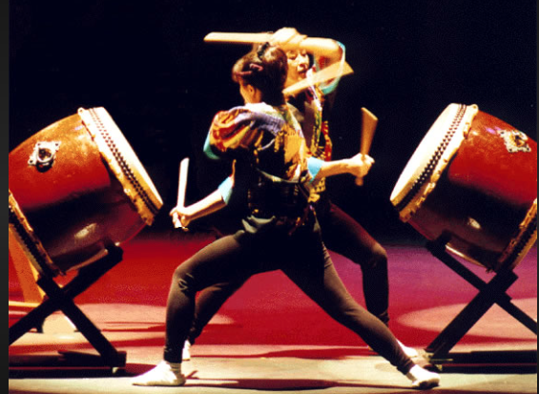
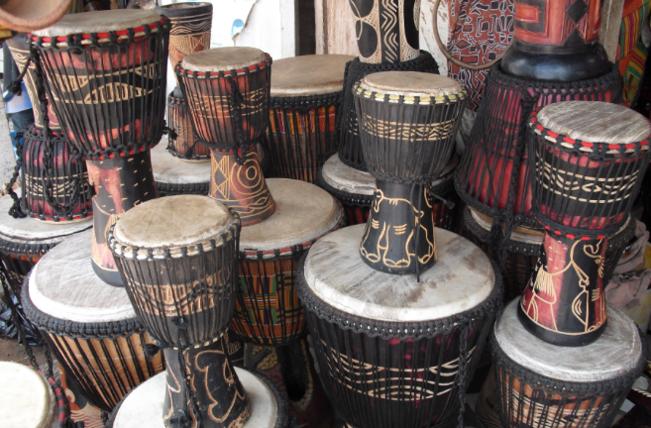
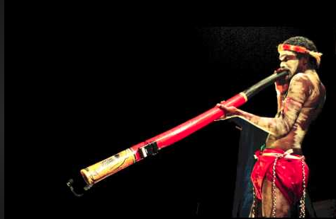
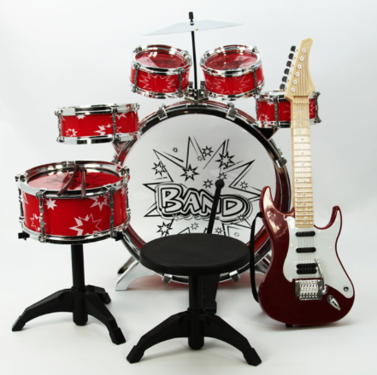
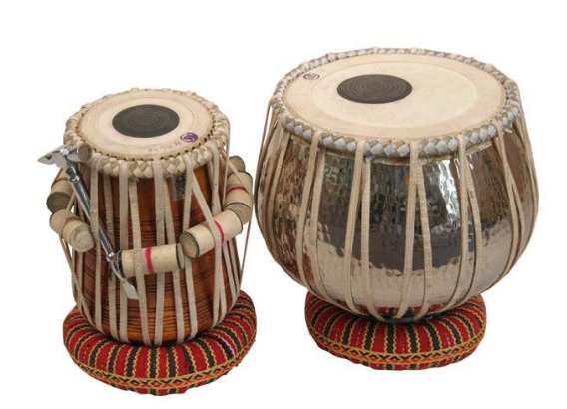
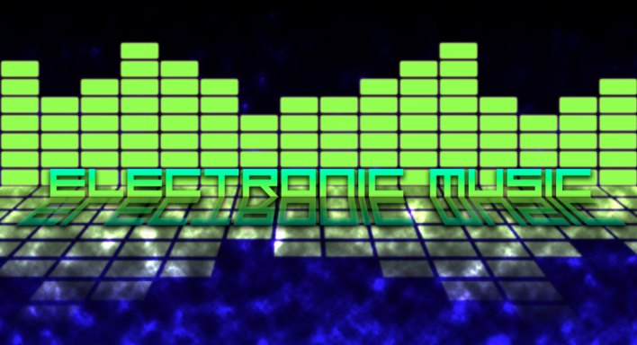
Instruments & Sounds
Taiko Drumming (Japan)
Tabla Drumming (India, Pakistan, Nepal)
Djembe Drum (Africa)
Cello (Traditional)
Didgeridoo (Australia)
Electric Guitar & Drum Set
Rap Lyrics
Electronic / Synthetic Sounds
Ethnochaos!

Slide 10
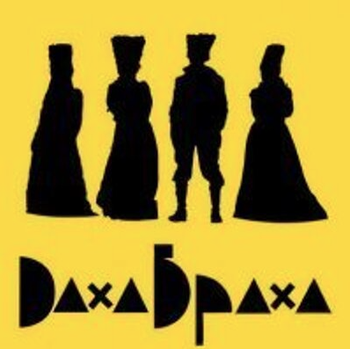
listen

Slide 11
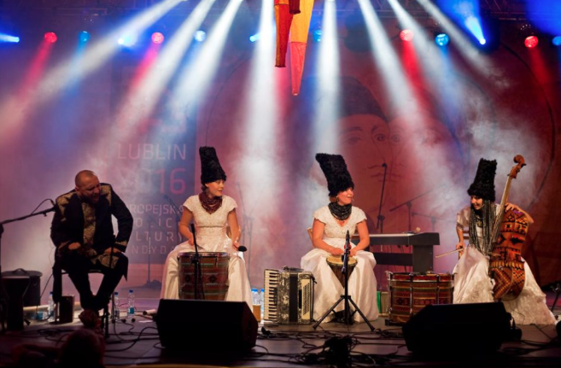
Costuming
[The costumes] give us additional energy.
We’ve decided now that when you wear the costume
you are DakhaBrakha
When you’re don’t, you’re not.

Slide 12
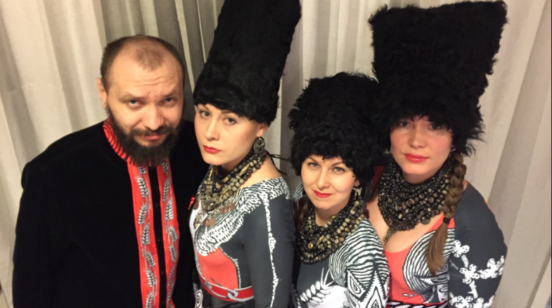
Interview

Slide 13
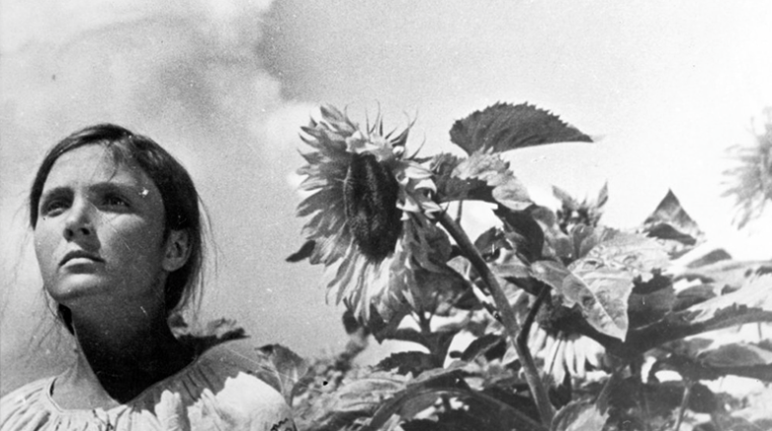
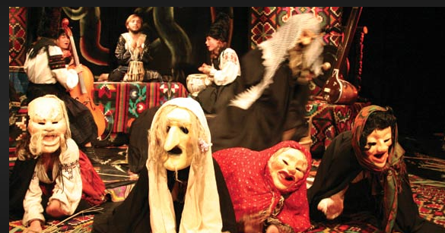
other projects
Created original score for Ukrainian film “Earth”
Film captures beauty of rural Ukrainian life
Film portrays Stalin’s collectivization project, which led to famine in Ukraine
Wrote “Mystic Ukraine,” a retelling of Shakespeare’s MacBeth set in modern Ukraine.
Uses music, theater, film, and dance to tell the story of Macbeth

Slide 14
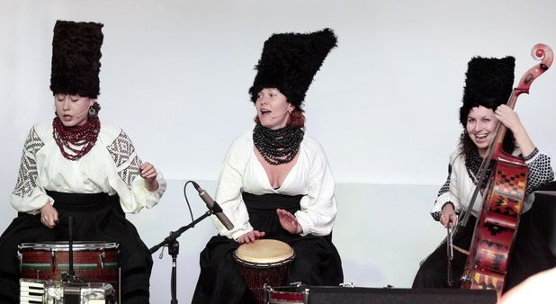
Watch DahkaBrahka on NPR’s Tiny Desk Concert

Slide 15
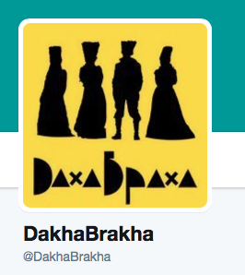
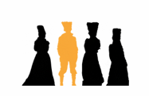
Twitter & website
http://www.dakhabrakha.com.ua

Slide 16
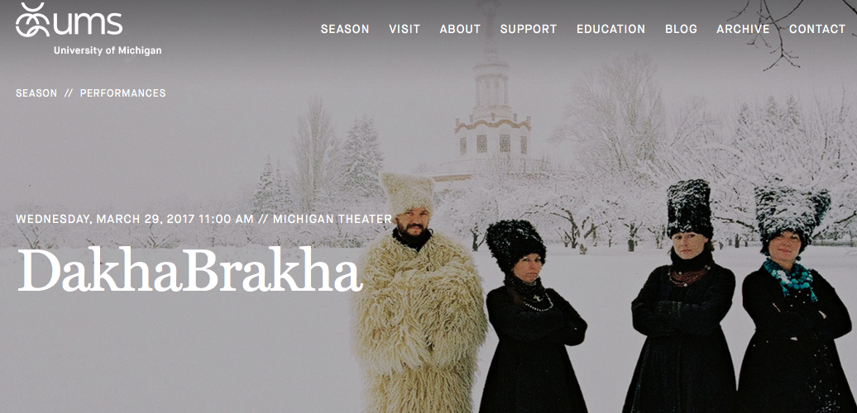
Thanks to UMS
Facts & Details from UMS Learning Guide

